Slide 1



Java Bootcamp 2018
Class 1: Introduction

Slide 2
Java Bootcamp 2018 - Class 1: Introduction
What is a Java Developer?

Slide 3

Java Bootcamp 2018 - Class 1: Introduction
What is a Java Developer?

Slide 4

Java Bootcamp 2018 - Class 1: Introduction
What is a Java Developer?

Slide 5

Java Bootcamp 2018 - Class 1: Introduction
What is a Java Developer?

Slide 6
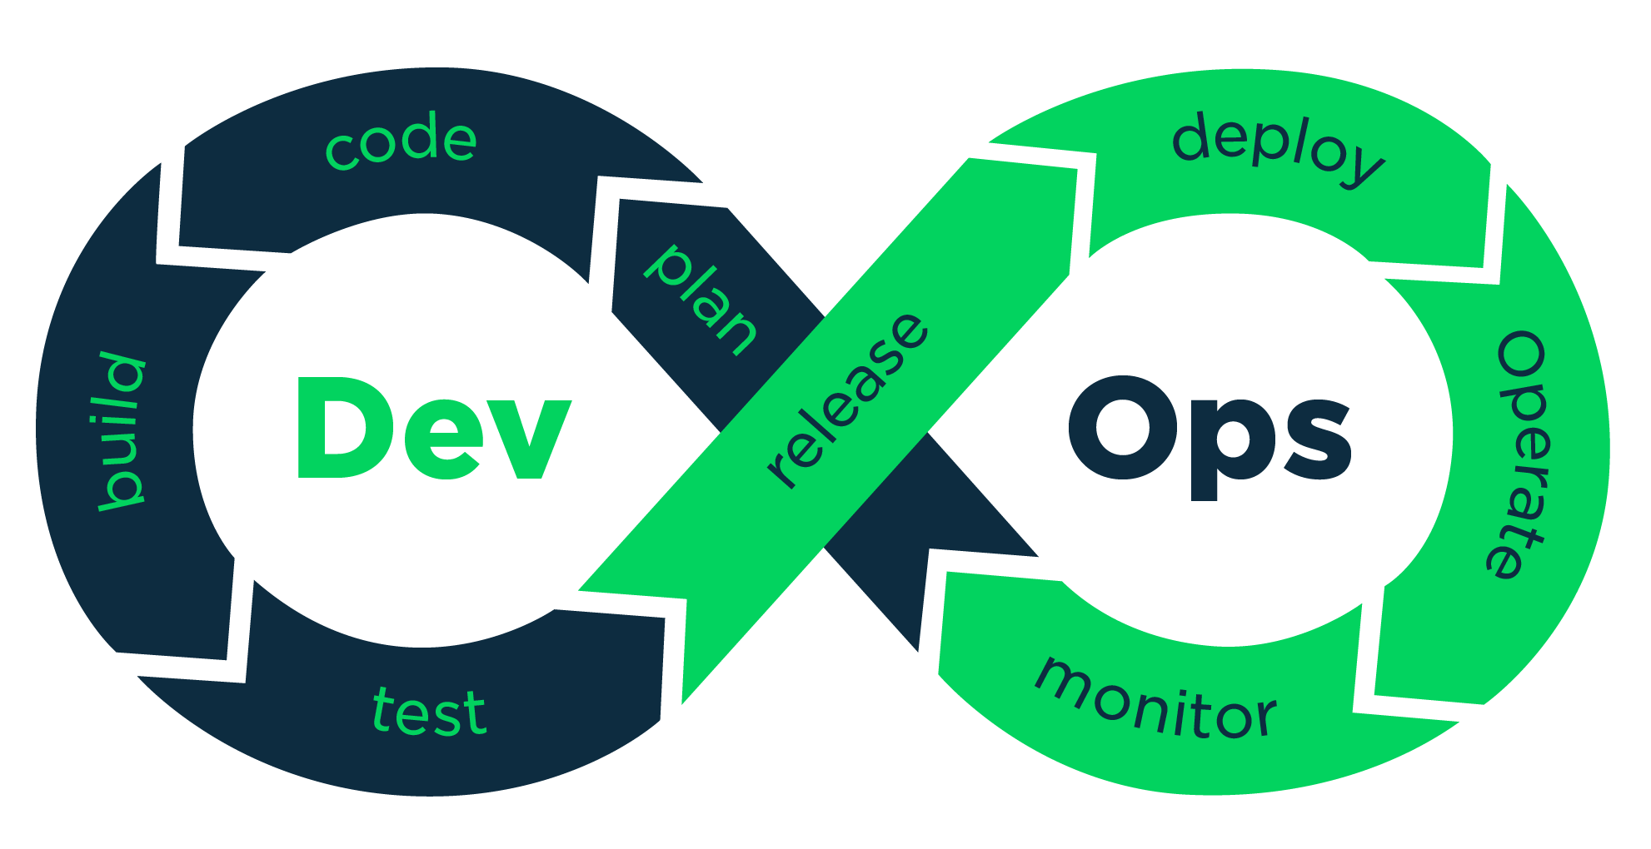
Java Bootcamp 2018 - Class 1: Introduction
What is a Java Developer?

Slide 7

Java Bootcamp 2018 - Class 1: Introduction
What is a Java Developer?

Slide 8

Java Bootcamp 2018 - Class 1: Introduction
What is a Java Developer?

Slide 9
Java Bootcamp 2018 - Class 1: Introduction
Bootcamp

Slide 10
Java Bootcamp 2018 - Class 1: Introduction
Bootcamp
Provide basic technology stack needed for any real project

Slide 11
Java Bootcamp 2018 - Class 1: Introduction
Bootcamp
Provide basic technology stack needed for any real project
Collaborative work (3-4 people/team) to simulate real project

Slide 12
Java Bootcamp 2018 - Class 1: Introduction
Bootcamp
Provide basic technology stack needed for any real project
Collaborative work (3-4 people/team) to simulate real project
Final work delivery applying every learned concept during the course

Slide 13
Java Bootcamp 2018 - Class 1: Introduction
Bootcamp
Provide basic technology stack needed for any real project
Git
Maven
Java basics
Spring
JUnit / EasyMock
RDB
REST
Collaborative work (3-4 people/team) to simulate real project
Final work delivery applying every learned concept during the course

Slide 14
Java Bootcamp 2018 - Class 1: Introduction
Bootcamp
Provide basic technology stack needed for any real project
Collaborative work (3-4 people/team) to simulate real project
Random teams
Client which will specify tasks and deadlines
Github
Splitting tasks is up to you
Final work delivery applying every learned concept during the course

Slide 15
Java Bootcamp 2018 - Class 1: Introduction
Bootcamp
Provide basic technology stack needed for any real project
Collaborative work (3-4 people/team) to simulate real project
Final work delivery applying every learned concept during the course
Individual and group demo
Additional features will be recognized
UI integration

Slide 16
Java Bootcamp 2018 - Class 1: Introduction
Bootcamp
Duration: 6 weeks
Attend Globant once a week
One additional week to finish Final Work

Slide 17
Java Bootcamp 2018 - Class 1: Introduction
How to Start
Create Slack user and join https://globant-bootcamps2018.slack.com
service-teams channel for any doubt
Fork github repository: https://github.com/ilanrosenfeld7/globant-bootcamps-java
A branch per team will be available
Create simple Spring Initializr project: https://start.spring.io/
IDE: whichever you want

Slide 18
Java Bootcamp 2018 - Class 1: Introduction
Any questions?

